Slide 1



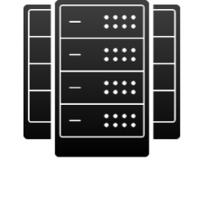
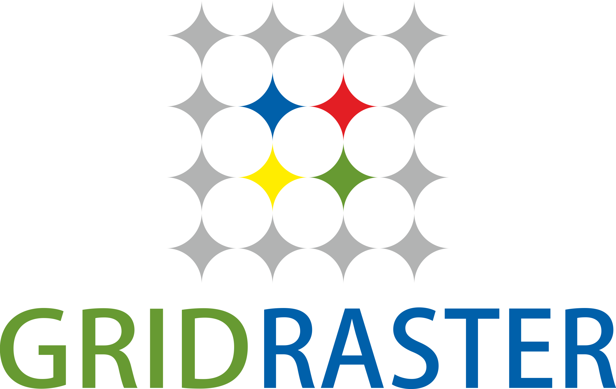
Solution: GridRaster Mixed Reality Cloud Platform
True Immersive MR: Powered by Edge/Remote Compute and Vision Based 3D AI
Customer Systems & 3D Content
Workflow Solutions
MES-1
MES-2
3D Geometry
Camera/Sensor Data
(Spatial Mapping)
WiFi/4G-LTE/5G
APIs
Multiple HMDs
or mobile devices
Cable/Fiber
Visual Rendering
Wireless
Access Point
MR Cloud
Cloud/Edge/On-premise Server
(on-device reconstruction)
GridRaster Solution
Reconstruction
3D AI
Rendering
Spatial mapping and 3D world reconstruction from camera images
Complete 3D scene understanding using deep learning
Infusion of virtual and real worlds,
visual rendering and tracking
Signaling Server, Scalar, QA

